Slide 1
Introduction To TensorFlow and Sentiment Analysis

Slide 2
References
The examples used during the introductions were extracted from the following reference:
  O’Reilly Learning TensorFlow - Tom Hope, Yehezkel S. Ressheff & Itay Lieder -
  Fundamentals of Machine Learning for Predictive Data Analytics: Algorithms, Worked Examples, and Case Studies (MIT Press) - John D. Kelleher, Mac Namee, Brian, Aoife D'Arcy -
  Udacity Artificial Intelligence Nanodegree.
  Deep Learning Ian Goodfellow, Yoshu Bengio and Aaron Courville.

Slide 3
Content
Introduction to TensorFlow
Natural Language Processing IMDB reviews sentiment analysis

Slide 4
Agenda
What is a Tensor?
What is a Graph Theory?
What is TensorFlow?
Installing TensorFlow
TensorFlow and Graph Theory Relation
TensorFlow Language Objects
TensorFlow and NN Model Hidden Layers
Linear regression and Logistic Regression
Natural Language Processing and Tensorflow

Slide 5
Session Environment
Operating System Linux
Hardware My Laptop
Programing Language Python
Jupyter Notebooks
Notes:
Python was the first client language supported by TensorFlow and currently supports the most features. More and more of that functionality is being moved into the core of TensorFlow (implemented in C++) and exposed via a C API. Client languages should use the language's foreign function interface (FFI) to call into this C API to provide TensorFlow functionality.

Slide 6
What is a Tensor?
Tensor: a multidimensional array, and extension of two-dimensional tables (matrices) to represent data with higher dimensionality.
Vectors Matrices and their relation with Tensors.
Let us see how these three types of data representation look in Tensorflow
Notes:
Activate conda tensorflow environment.
$>source activare tensorflow
Run ipython
$>ipython
Vector
In [22]: import numpy as np
In [23]: vector = np.array([1,2,3,4,5,6])
In [23]: vector.shape
In [25]: vector.reshape(6,1))
Matrix
In [27]: matrix = np.array(([1,2,3],[4,5,6]))
In [29]: matrix.shape
In [28]: matrix
Tensor
import matplotlib.pyplot as plt
import matplotlib.image as mpimg
img = mpimg.imread('image/rpo.png')
imgplot = plt.imshow(img)
plt.show()
img.shape
Just one matric of the three
img[0:,:,0].shape
Tensor 2
np.array(([[[1.1],[1.2],[1.3]],[[2.1],[2.2],[2.3]],[[3.1],[3.2],[3.3]]]))

Slide 7
What is a Graph?
“...mathematical structures used to model pairwise relations between objects. A graph in this context is made up of vertices, nodes, or points which are connected by edges, arcs, or lines. A graph may be undirected, meaning that there is no distinction between the two vertices associated with each edge, or its edges may be directed from one vertex to another...” (https://en.wikipedia.org/wiki/Graph_theory)
x
matmul
add
sigmoid
Nodes
W
Edges
b

Slide 8
What is TensorFlow?
“Is a software framework for numerical computation based on dataflow graphs”. (O’reilly Learning TensorFlow A Guide To Building Deep Learning Systems)
Graph
Operations:
  Source
  Mathematic
Namespaces
Sessions
Tensor
Vector
x
matmul
add
sigmoid
W
Matrix
b

Slide 9
Installing TensorFlow
Miniconda (https://conda.io/miniconda.html)
Create python environment
Add the packages:
  Jupyter
  Pandas
  Numpy
  Matplotlib
  Tensorflow
  Tensorflow-gpu
Notes:
Create container:
$>sudo docker run --rm -v /home/gaure/Google_Drive/Tensorflow_Course/conda/:/conda -it centos:latest /bin/bash
After creating the container and before installing Miniconda install bzip2
$>yum -y install bzip2
Reload the bash profile
$>. ./.bashrc
Create environment:
$>conda create -n tensorflow python=3.6
Install all the packages listed in the slide running the following command:
$> conda install <package_name>
Example:
$>conda install tensorflow

Slide 10
TensorFlow objects
As any programming framework TensorFlow has objects and operations.
Math Operations | Source Operations | Tensor Objects
tf.add() tf.multiply() tf.subtract() tf.divide() tf.matmul() | tf.constant() tf.fill() tf.random_normal() tf.zeros() tf.truncated_normal() | tf.placeholder tf.variables

Slide 11
TensorFlow and computational Graph
Let us build one basic TensorFlow Graph
b
Add
Mul
a
c
Notes:
Define your graph
In [22]: with g.as_default():
...: with tf.name_scope('add'):
...: a = tf.constant(4, dtype=tf.float32, name='a')
...: b = tf.constant(5, dtype=tf.float32, name='b')
...: with tf.name_scope('multiply'):
...: c = tf.constant(10, dtype=tf.float32, name='c')
...: print("Namespace add constants names: {} {}".format(
...: a.name, b.name))
...: print("Namespace multiply constant name {}".format(
...: c.name))
...: s = a + b
...: m = s * c
...: with tf.Session() as sess:
...: out = sess.run(m)
...: print("Result: ",out)

Slide 12
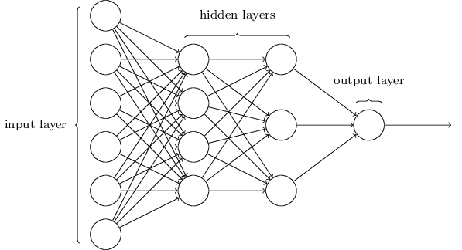
Tensorflow and hidden layers
TensorFlow has higher level objects that can be used to built complex neural network Graph representations.
Some of this higher level objects can be used to build different types of hidden layers: tf.contrib.rnn, tf.conv2d, tf.nn.maxpool, tf.nn.dropout, etc.

Slide 13
Tensorflow Linear regression and Logistic Regression
To see examples of TensorFlow examples of Linear Regression and Logistic Regression open the Jupyter Notebook named: “TensorFlow_Regression.ipynb”
To open the notebook, once you activate your tensorflow conda environment just run:
$>jupyter notebook TensorFlow_Regression.ipynb
Notes:
Linear Regression: Is a way to model the linear relation between a depending variable and one or more independent variables.
Logistic Regression:
Logistic regression is a statistical method for analyzing a dataset in which there are one or more independent variables that determine an outcome. The outcome is measured with a dichotomous variable (in which there are only two possible outcomes)

Slide 14
Tensorlow Natural Language Processing and Tensorflow
Using TensorFlow and RNN LSTM we will predict the sentiment of the IMDB reviews.
We will use an embedding layer to learn a mapping representation of each movie review, them we will feed the LSTM neural network from the embedding output.
NLP problems steps:
  Collect Data (feature – words – , labels – boolean –)
  Normalization & Tokenized
  Padding
  Extract features (embedding)
  Modeling (neural network)
Once in your tensorflow conda environment open the Jupyter notebook called “Sentiment_RNN.ipynb”. You can do this running: “$> jupyter notebook Sentiment_RNN.ipynb”
In the next slide we will see an LSTM cell internal gates representation.

Slide 15
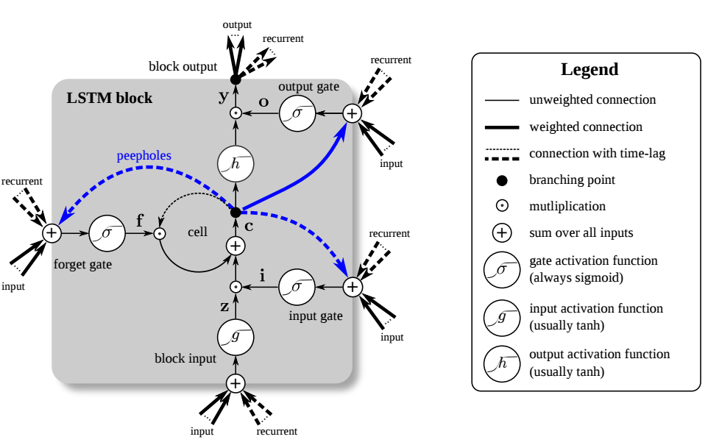
Tensorlow Natural Language Processing and Tensorflow

